Slide 1
Employee Reviews & KNN
Rebecca Rozansky

Slide 2
About the dataset
The data was taken from Glassdoor about six different tech companies (apple, amazon, netflix, google, microsoft, and facebook) and separated into many different categories
Ex: company name, summary reviews, pros and cons, location of the company, overall rating stars, work balance stars, culture value stars, and senior management stars

Slide 3
Issues with the Dataset
The size was 67,000 data points and forced me to wait a while for everything to load
A lot of the responses were left blank in categories
The companies weren’t equally distributed (26,000 Amazon reviews and 810 Netflix reviews)

Slide 4
Scrubbing the Dataset
Since most of the data was qualitative I removed a lot of it:
Ex: location, job title, date, etc
Because I didn’t think that stars left on a review were enough data to properly use KNN, I used sentiment analysis to replace the reviews left with a number

Slide 5
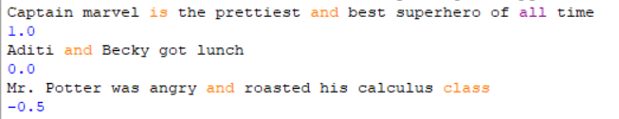
Sentiment Analysis
Sentiment analysis is the process of determining how positive or negative a certain phrase is by assigning that phrase a value from 1 to -1
Ex:

Slide 6
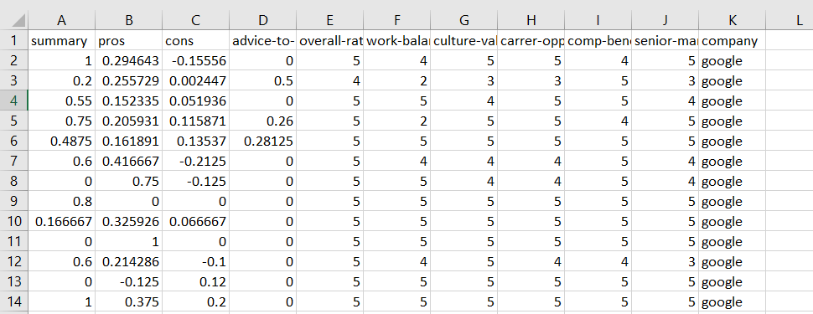

Slide 7
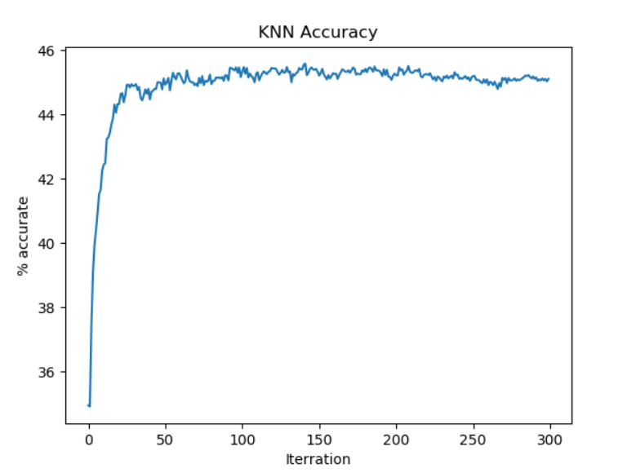
How was the accuracy?
The highest accuracy was at a k-value of 143 with an accuracy of 45.23%

Slide 8
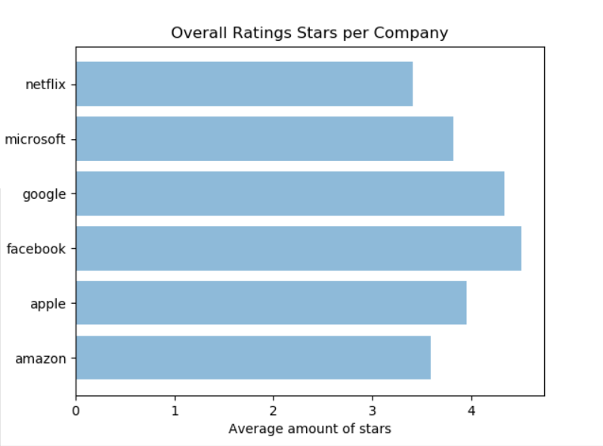
Do reviews left for different companies differ drastically?
The happiest employees worked at Facebook (4.5 stars was the average) and the most miserable employees worked at Netflix (3.4 was the average)

Slide 9
Conclusion
Even though I only achieved 45% accuracy, the KNN model worked three times better than simply guessing the company
Working for Amazon and Netflix seems like a bad idea and try to get a job at Facebook

